Slide 1
Assessment: ricky’s rides
Portfolio for 3.7 / 3.8

Slide 2
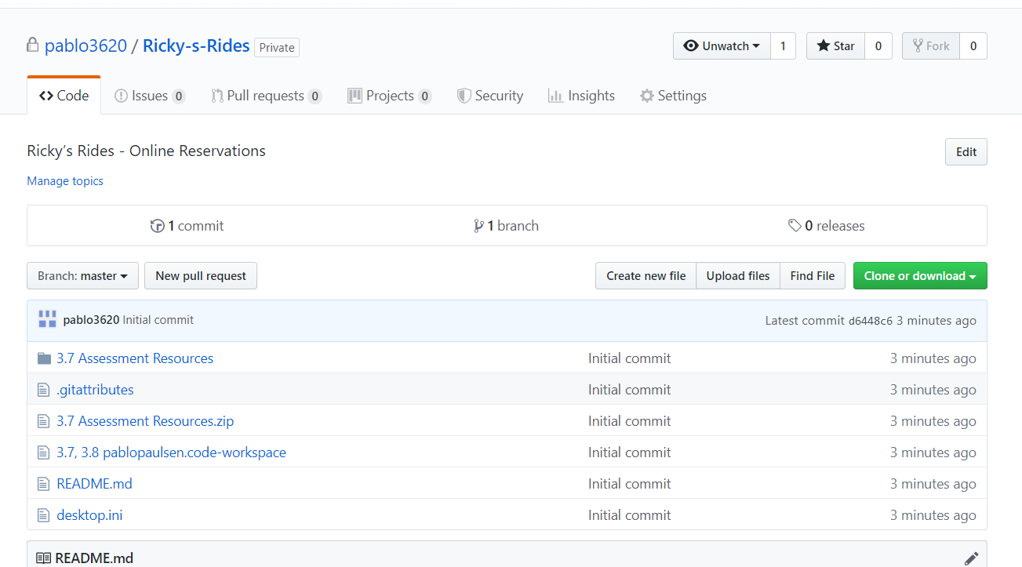
Create project management tools
In order to efficiently manage my project i made git hub project and uploaded all the given resources such as image. This will help later in the coding process as it helps organize all of the files in within visual studio.
It is also useful as it offers version control.

Slide 3
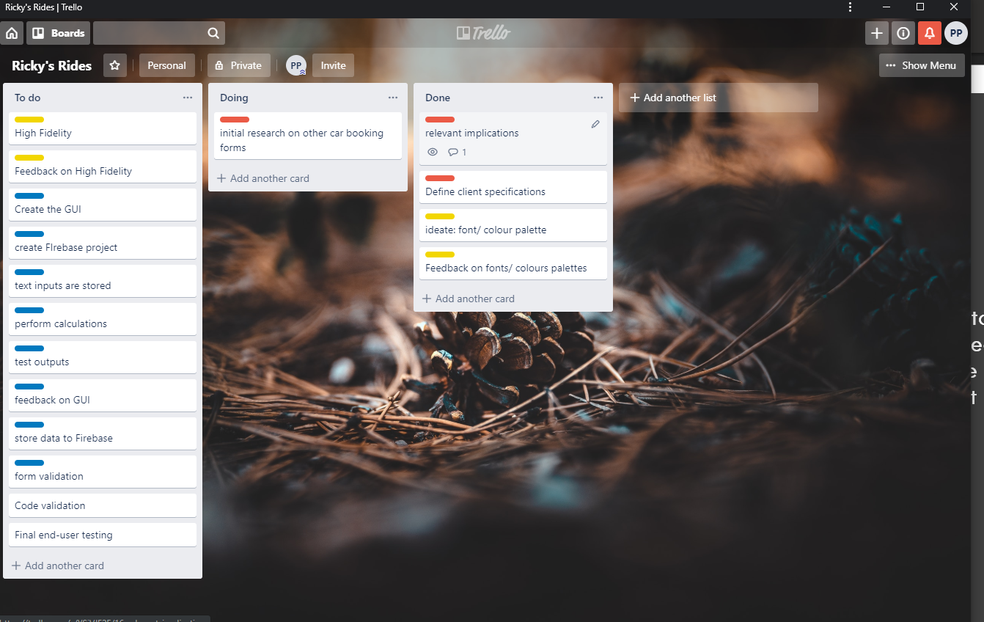
PROJECT MANAGEMENT TOOL: TRELLO
I am using trello to keep track of what I need to do and what is done in order to be more efficient.
I added a color-coded label for each card according to which step of the Design Thinking Step it applies to.

Slide 4
Step 1 : Define your relevant implications
What are 3 relevant implications you will be focusing on?
accessibility
Have clear contrast of font e.g white background with black font to improve readability
Make sure your page can scale across multiple devices e.g tablet, PC and phone using media queries
Use alt tags on images for blind people
Images are large enough to properly see
Usability
When designing your layout keep in mind the 10 Usability Heuristics, your design should adhere to consistency and standards
Keep your fonts/colours large, uncluttered and simple
Buttons should be obvious and on hover show cursor to indicate that it can be clicked
Error messages are relevant and easy to understand and recover from
Future-proofing and sustainability
Code comments to help future coders understand your code
Avoid hardcoding JavaScript variable so that content can be updated without breaking the code
Use DIV tag rather than HTML5 tags to ensure a consistent and accurate design
CSS3 is the most up to date style sheet
Avoid using plug ins
In the footer, note the year the site was created and by whom so users know it is up to date and can contact you.
Keep updating content to ensure that your information is correct

Slide 5
Step 1 : Define your audience
Who is your target audience?
People looking to rent cars. Mainly tourists and is therefore also some foreigners
These foreigners are mainly from Australia, china or the USA https://www.wikiwand.com/en/Tourism_in_New_Zealand
How are they most likely going to be viewing your GUI?
As they could be both booking from home before traveling or booking while on the go my site will be combatable with both desktop and mobile/tablet.

Slide 6
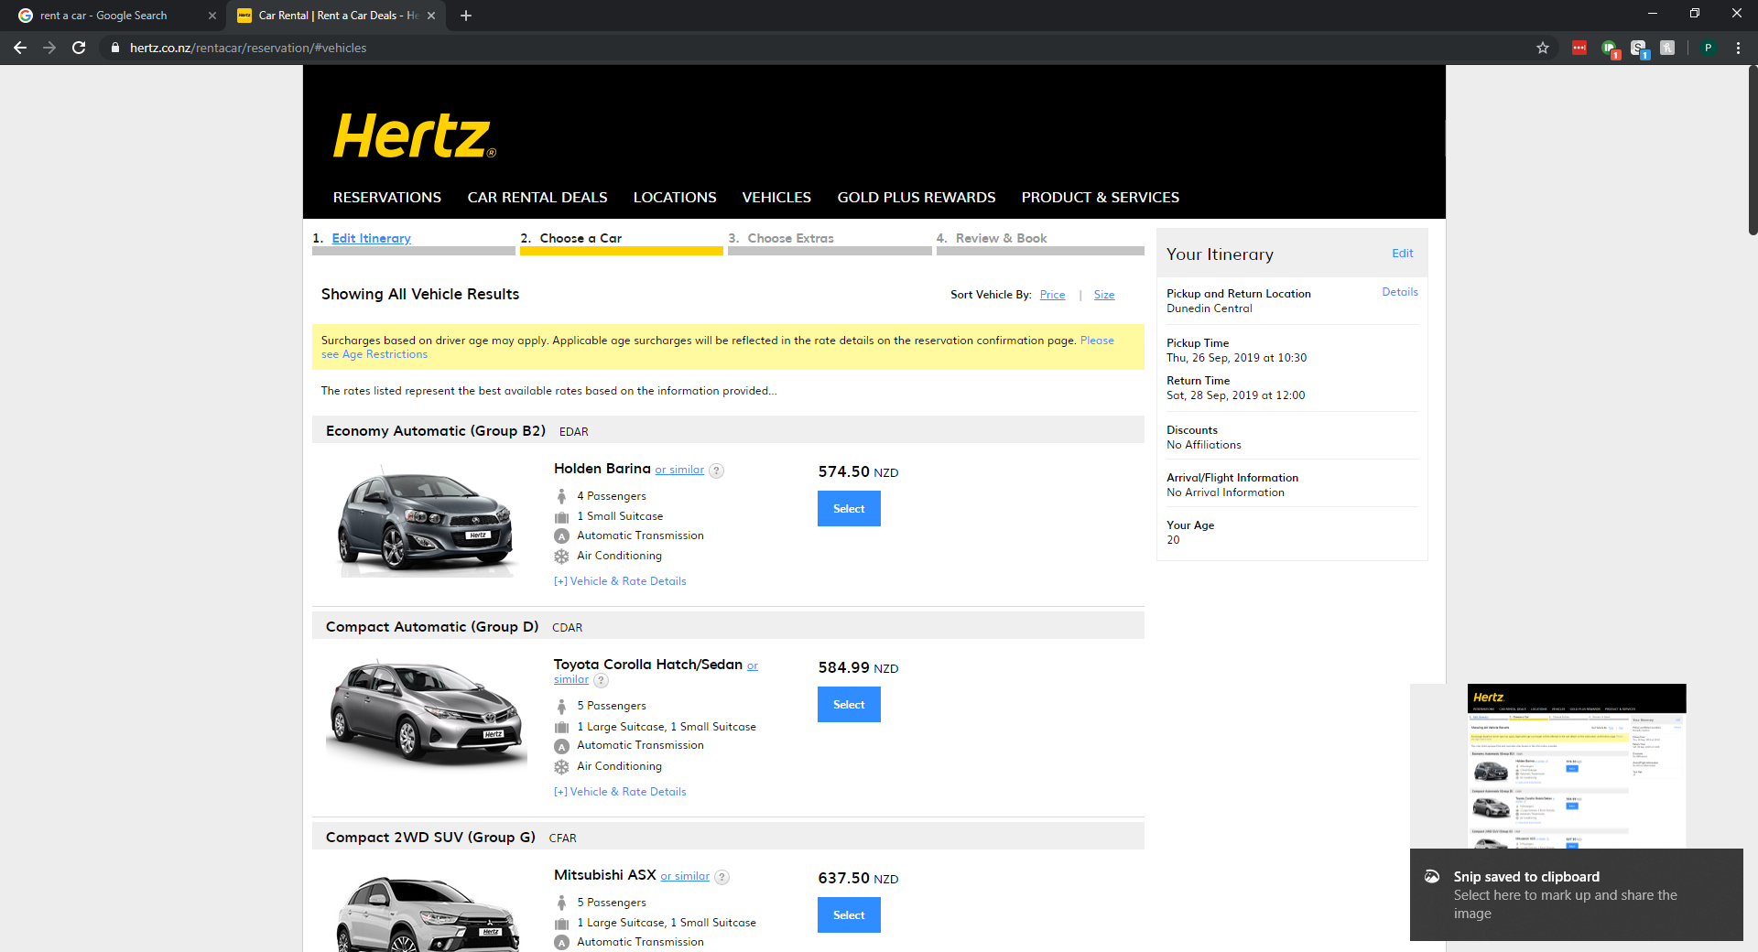
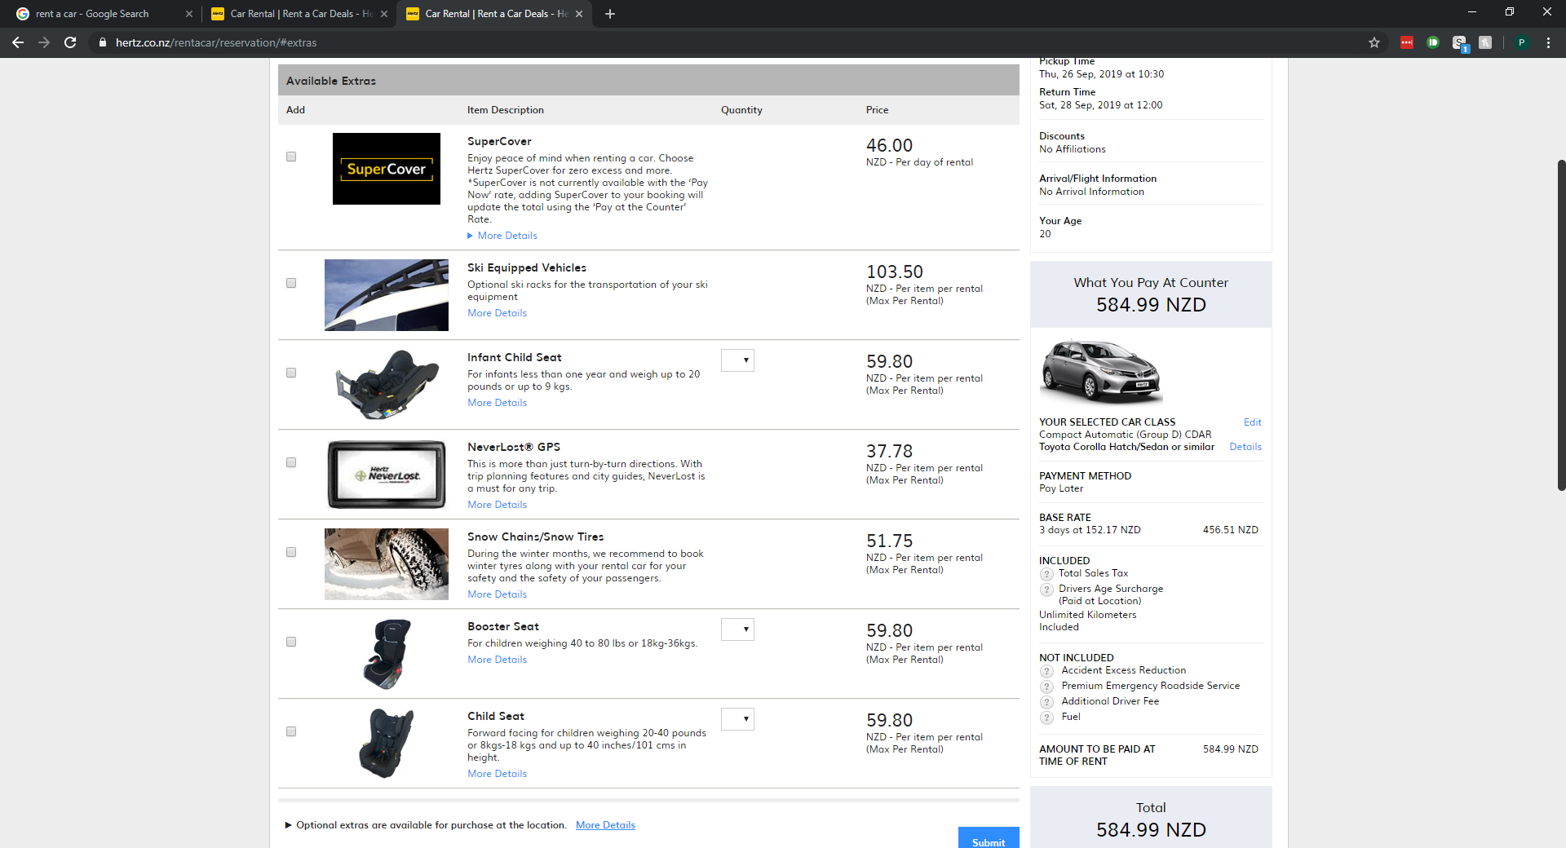
Research: Hertz
As hertz is an international company it starts with selecting a location. This would not be required for Ricky's rides as it a single location in Dunedin
It then allows the user to select time and then car. Car info is displayed as a list.
It then offers extras with current booking summary along the side.
After extras it asks for personal details before confirming the booking

Slide 7
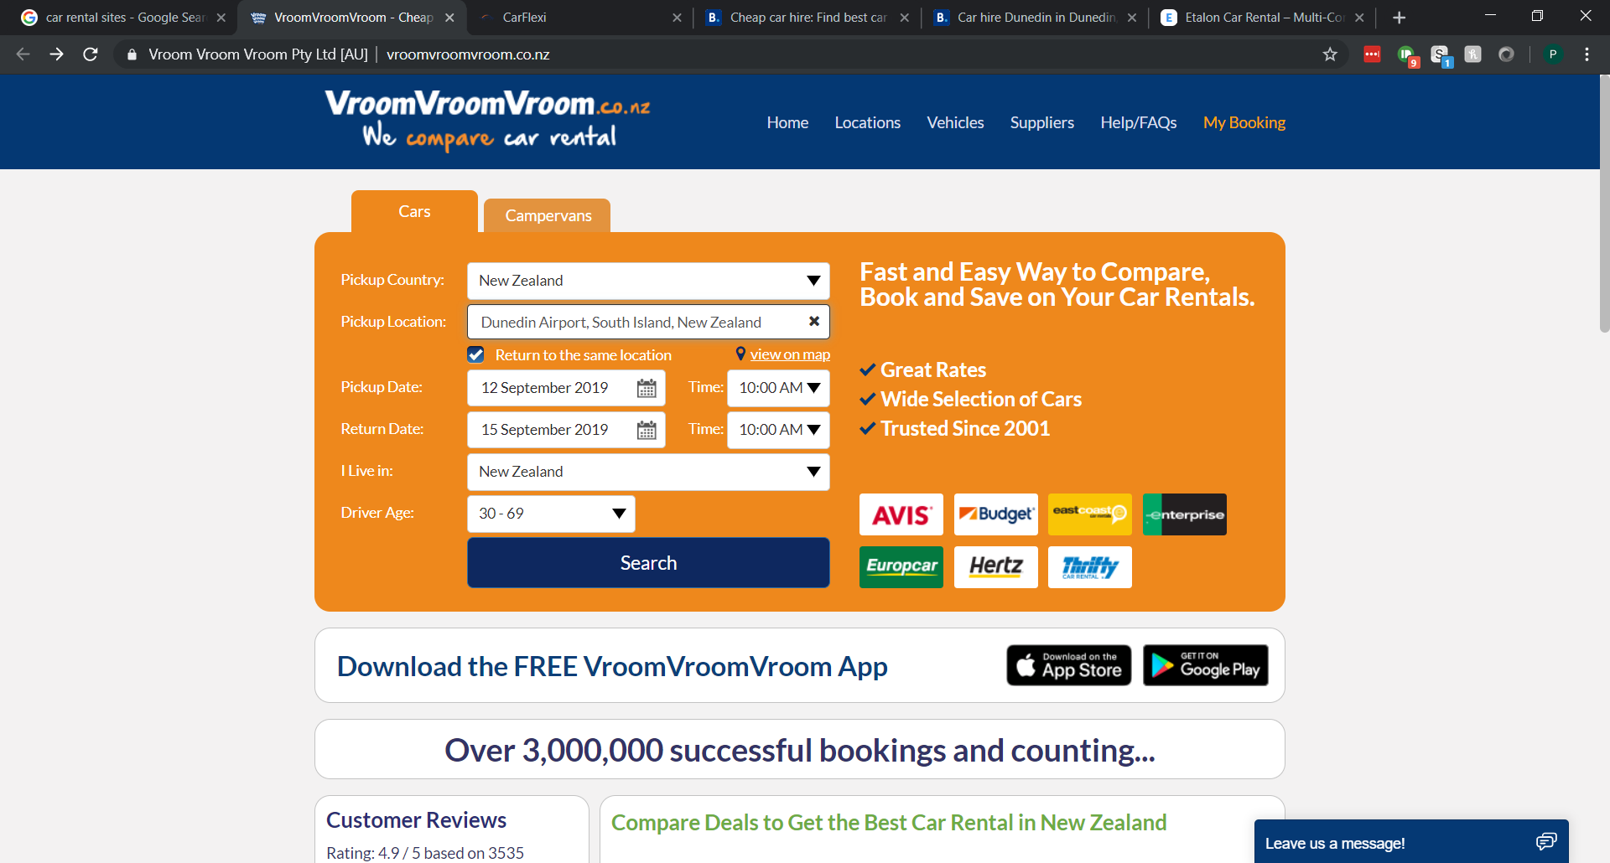
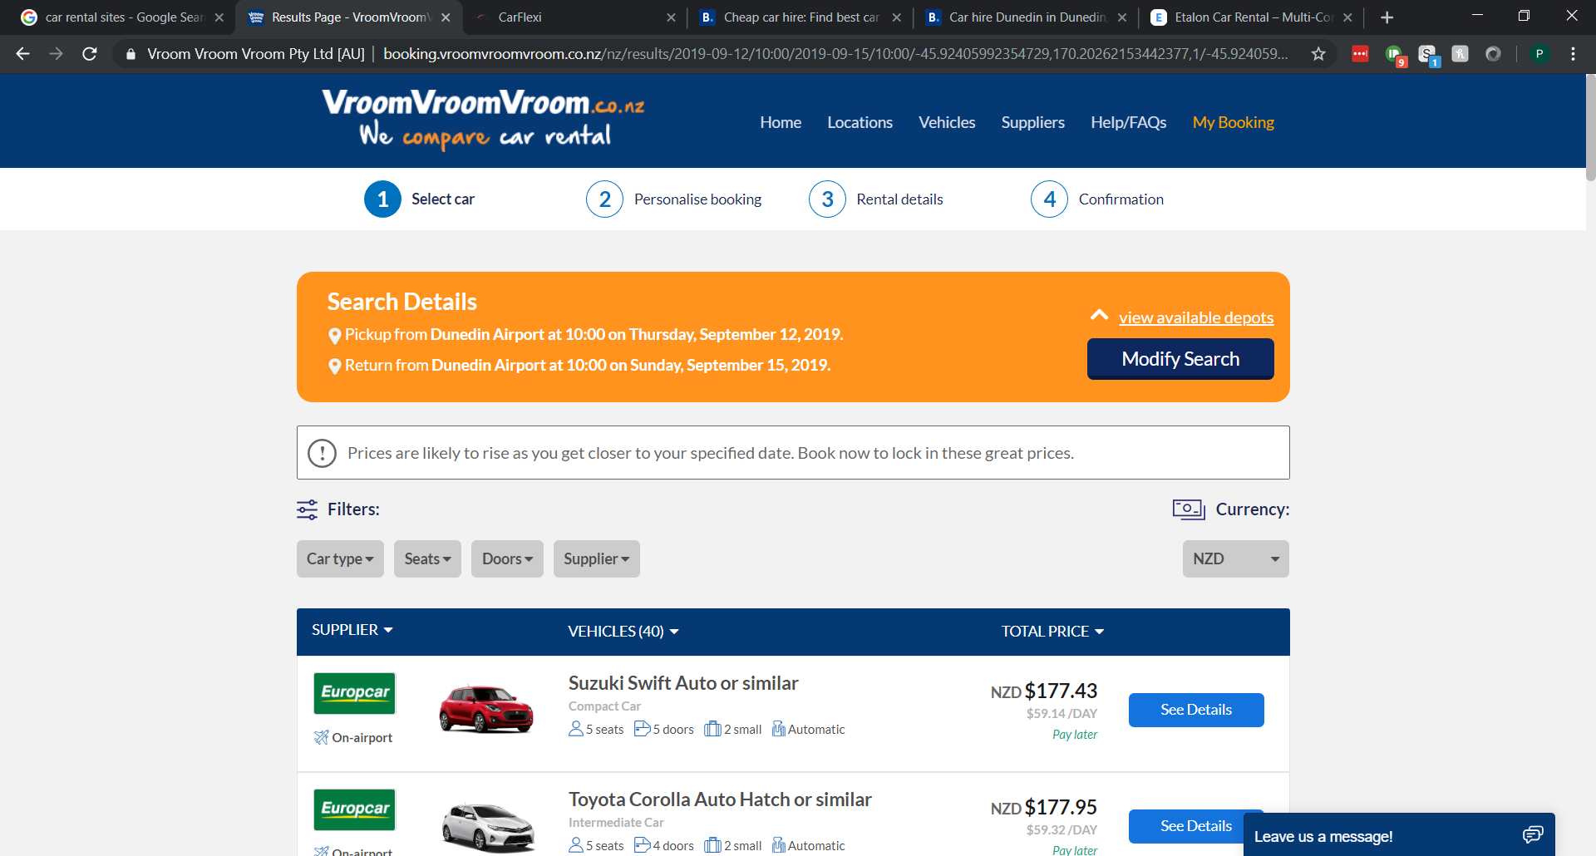
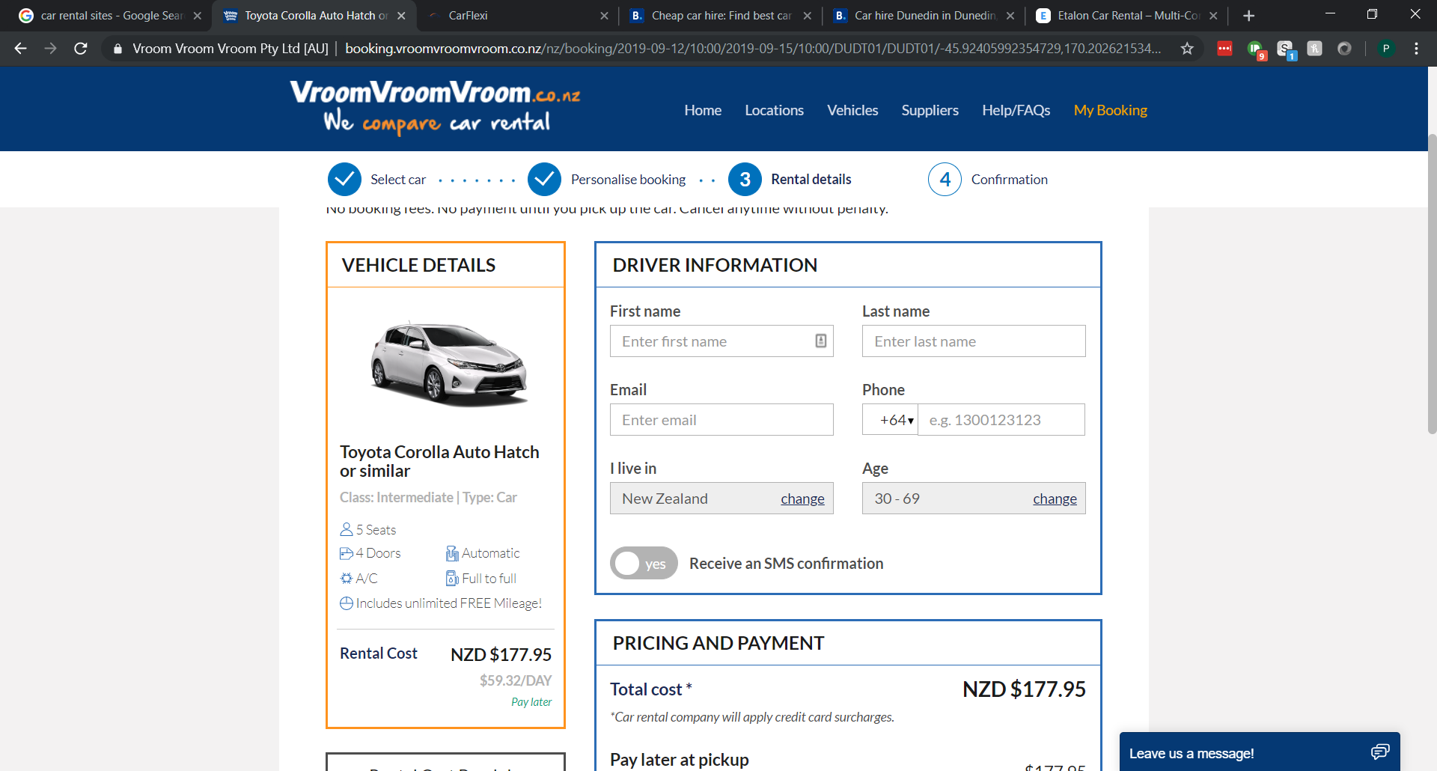
Research: vroomvroomvroom.co.nz
Vroomvroomvroom also splits the rental process into multiple pages/steps.
First asks for pickup date and return date
Next page is car selection with the cars and their prices listed with option to see more details
Final page before confirmation is driver information
Confirmation page show a summary of booking information

Slide 8
Research summary
The order that the sites tend to get info is to collect pickup and return date then select the car and then get the personal details of the driver
Most booking sites tend to use a pickup date and return date. However in the client specifications it asks for a pickup date and number of days. As number of days gives the same info as a return date I will use number of days instead of return date.
The booking forms tended to be split into multiple different pages/sections so that the user can not proceed with any errors. This makes error messages more relevant as it can only be on the current page and is therefore easier to understand and recover from.

Slide 9
Define the key steps of this project
Record the client specifications
Create Trello board to manage tasks
Ideate (wireframe (GUI), Google fonts / colours)
Prototype: Create the GUI, test inputs work, perform calculations, test outputs, form validation and error messages, create firebase project, connect to firebase and push data
Testing : ongoing and should involve A vs B testing with end users

Slide 10
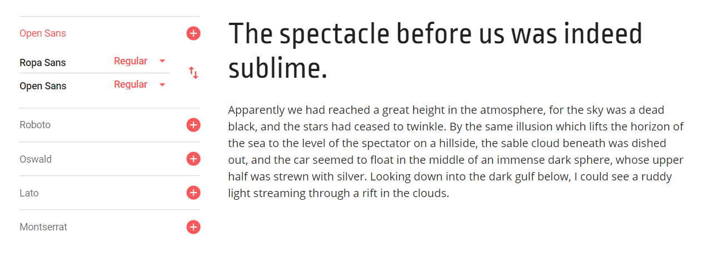
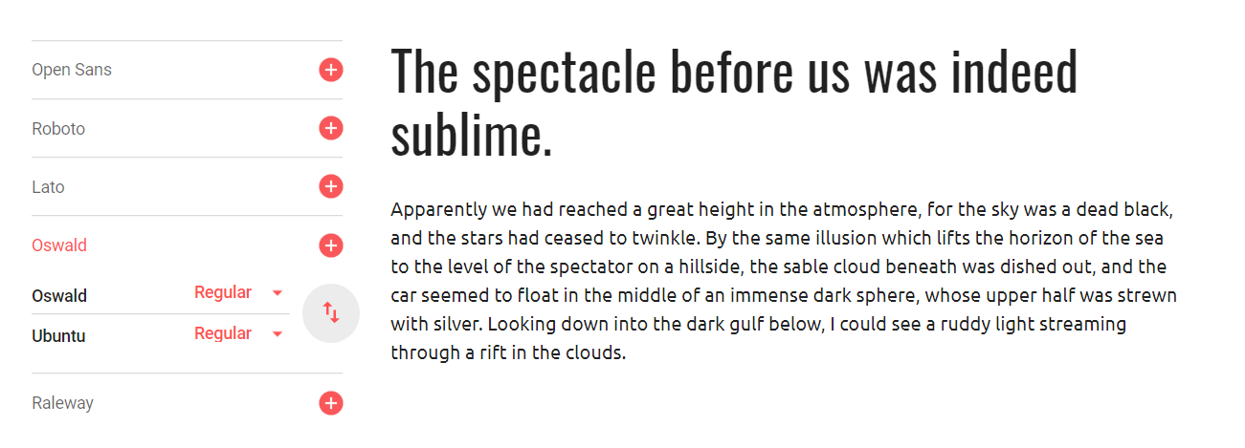
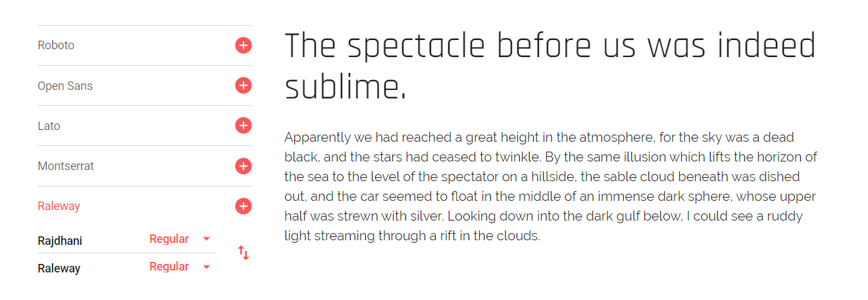
Font combinations
Ropa Sans Heading, Open Sans body
II
Oswald Heading, Ubuntu body
Rajdhani Heading, Raleway body
IIII
https://fonts.google.com/?query=rale&selection.family=Rajdhani|Raleway

Slide 11
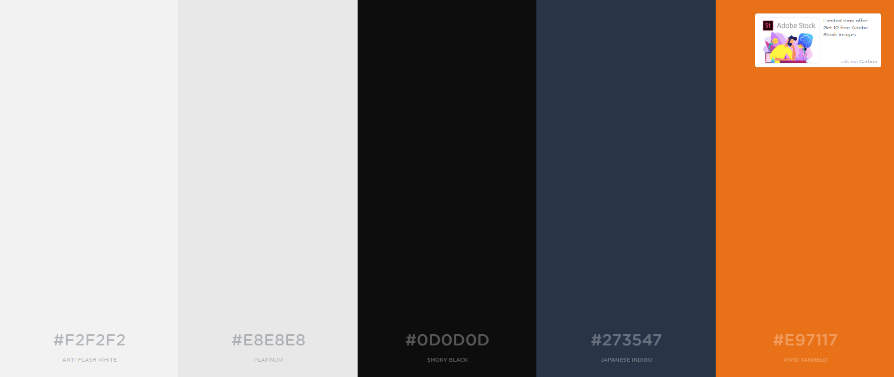
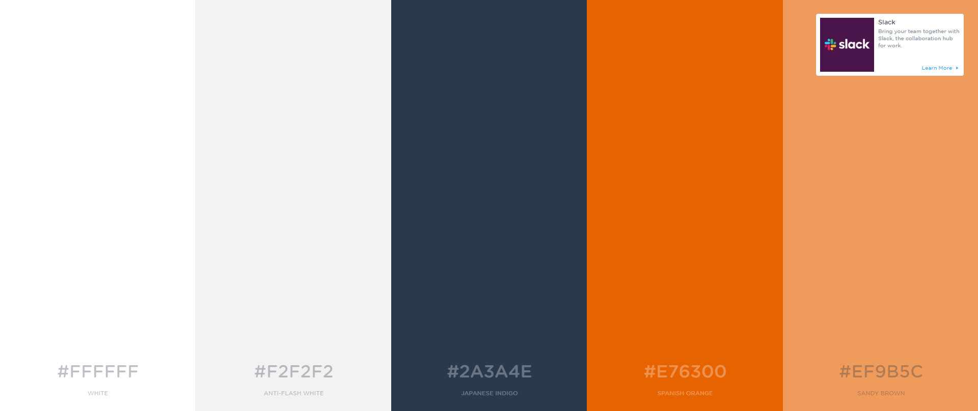

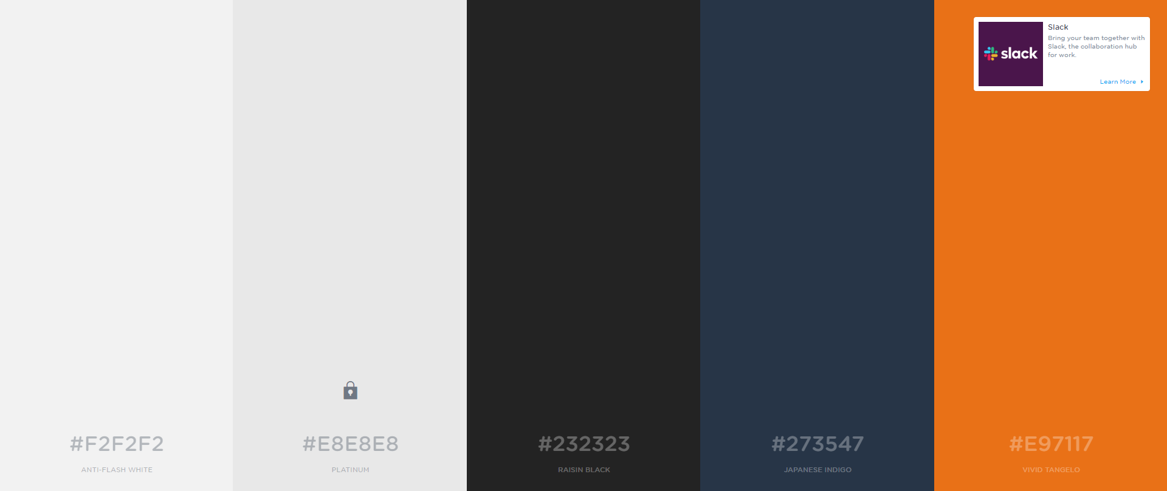
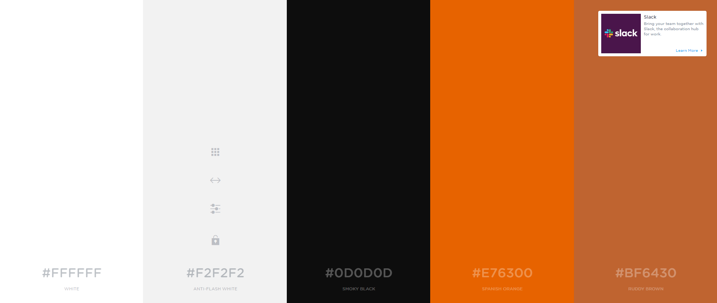
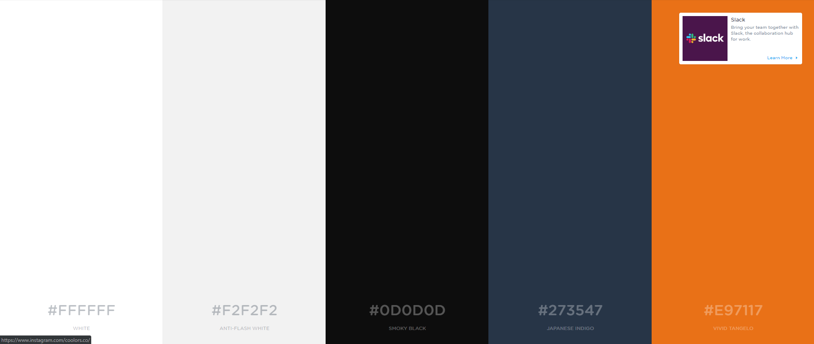
Colour palettes
1. I I I
2. I I
3. I I I I
4.

Slide 12
Feedback on fonts/colours
I received feedback in the form of votes for color combos and font combinations. After receiving vote the most popular color palette is the 3rd color palette. While the most popular font combination was Rajdhani Heading, Raleway body.

Slide 13
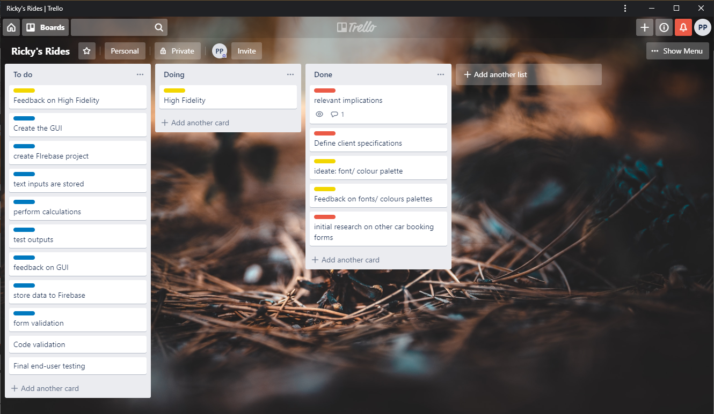
PROJECT MANAGEMENT TOOL: TRELLO
Current Trello board

Slide 14
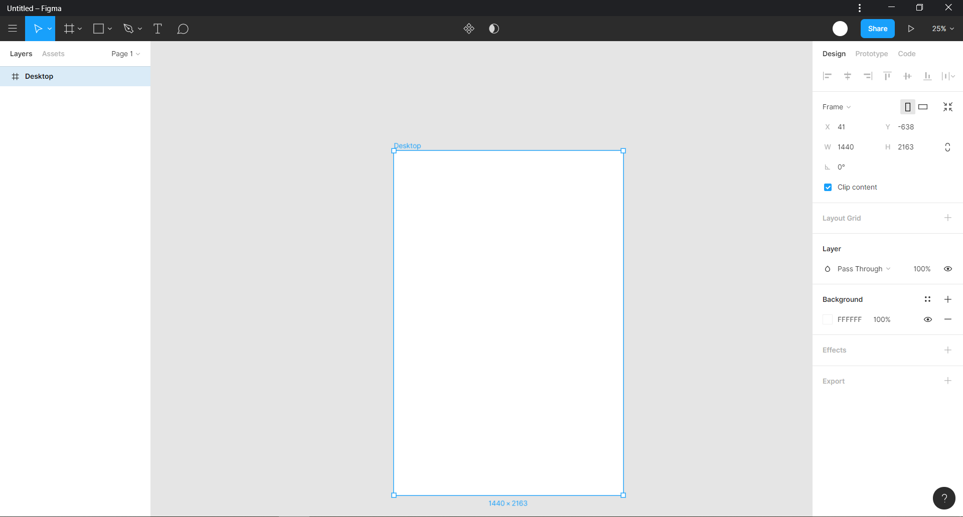
Step 2:Ideate (high fidelity wireframe)
For my high-fidelity wire frame I am using figma. This is as it is powerful design tool that is also web based and therefore easy to share and get feedback.

Slide 15
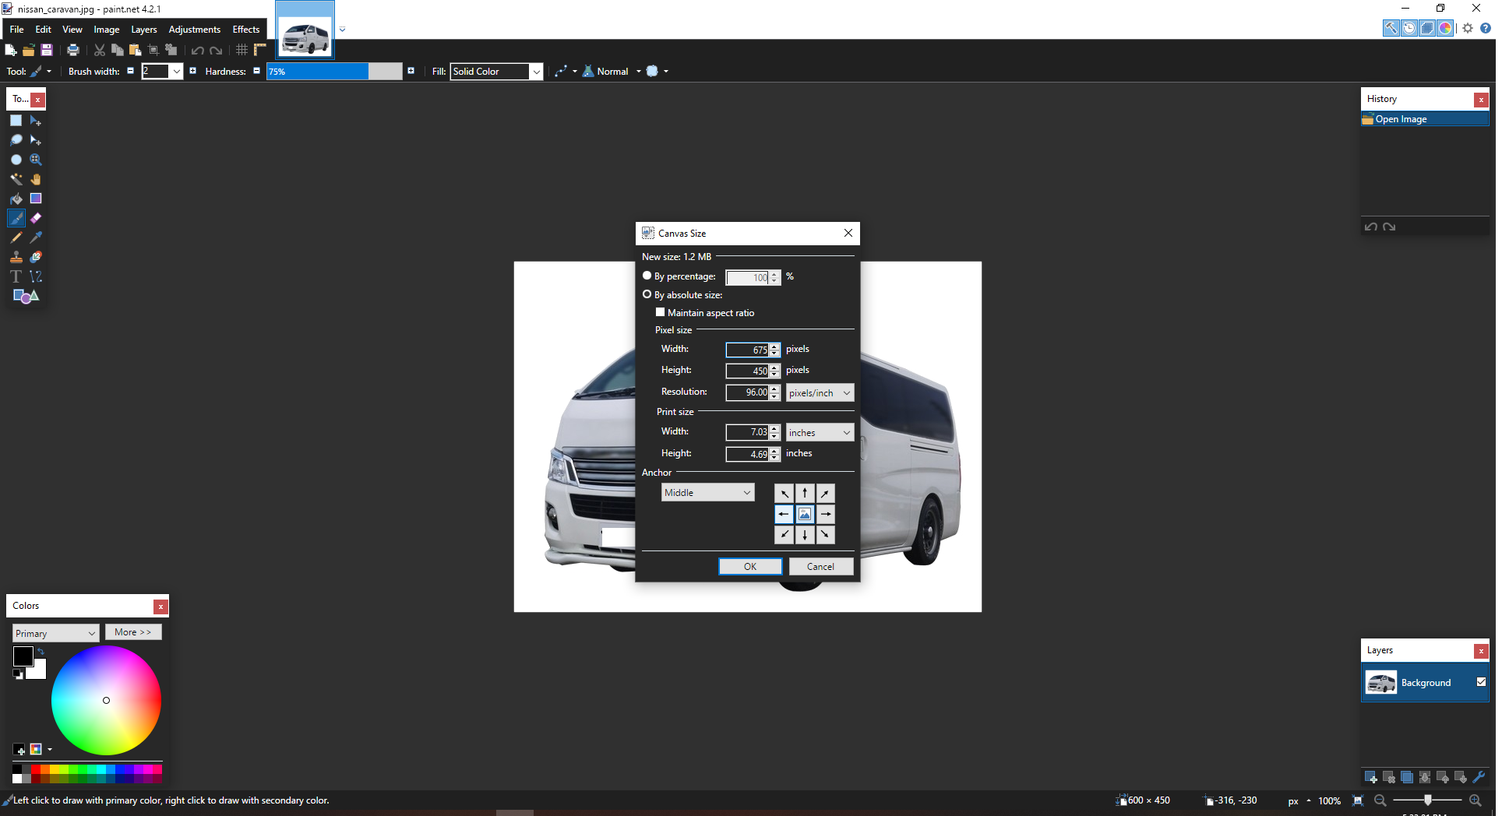
Image processing
As some of the images given were in different aspect ratios in order to not create issues when displaying the image on the page I made the aspect ratio of all the images to 3:2.

Slide 16
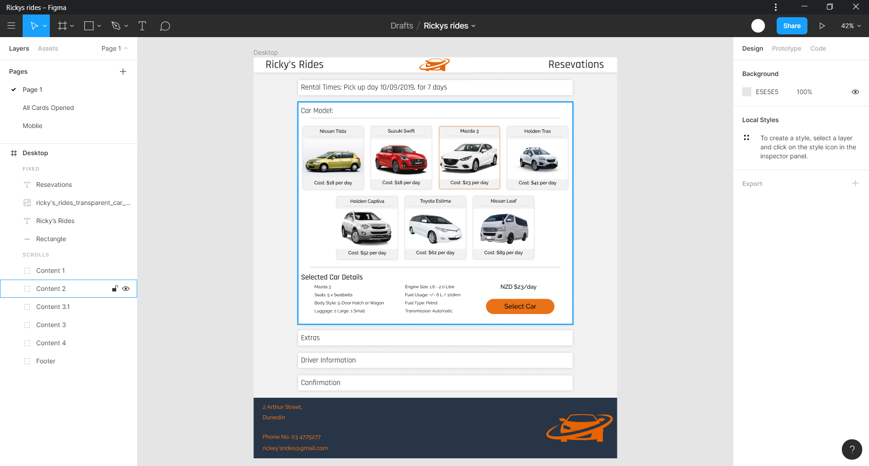
high fidelity wireframe
as according to my research I split my booking process into 5 different steps in the form of cards of which only one can be open at a time so that the user can not proceed with any errors
So that I could fully visualize the page I also made a high-fidelity page with all the cards open and I also made the mobile page with all the cards open
https://www.figma.com/file/rQoRVSm70X6THo0IHvMM0E/Rickys-rides-before-feedback?node-id=15%3A81

Slide 17
high fidelity wireframe – feedback – card layout
https://trello.com/c/I7OYechR
As I received positive feedback on the card layout used to separate different sections of the booking process, I will keep this design
final high-fidelity

Slide 18
high fidelity wireframe – feedback- navbar
https://trello.com/c/I7OYechR
I received some negative feedback about the placement of reservations text and logo in the nav bar. I therefore removed the reservations text and moved the logo to the right side.
final high-fidelity

Slide 19
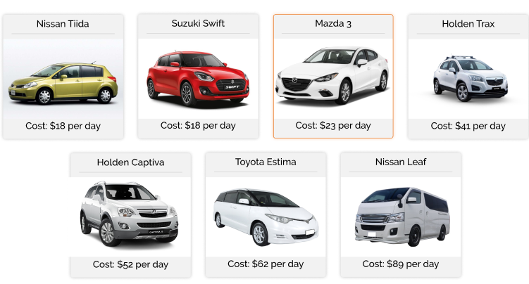
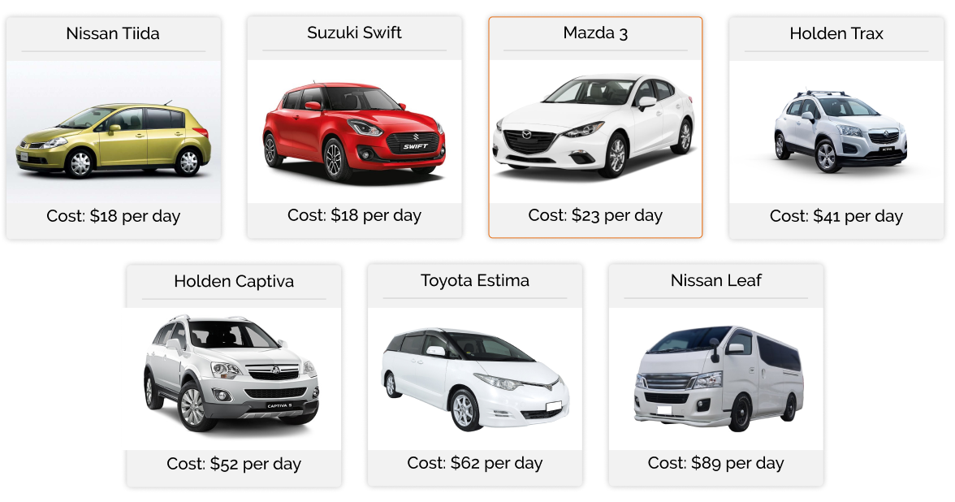
high fidelity wireframe – feedback- selected car border
https://trello.com/c/I7OYechR
I received feedback on the border of the selected card to also change the box-shadow to a slight orange. This made the selection of the card more obvious as it looks like the orange border around the card is an illumination effect to indicate that it is selected
final high-fidelity

Slide 20
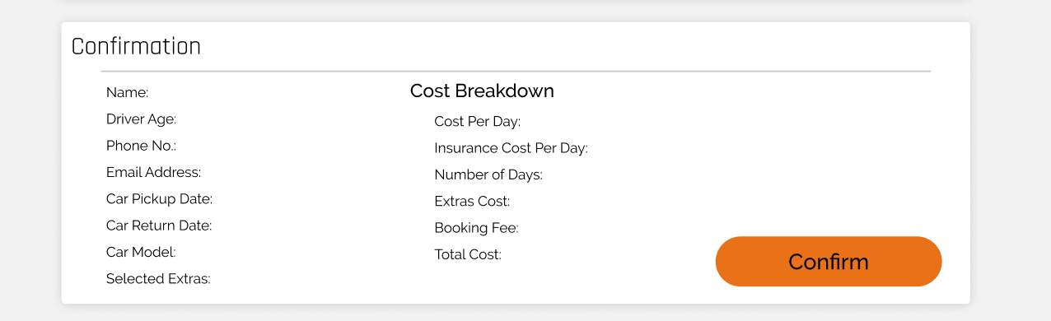
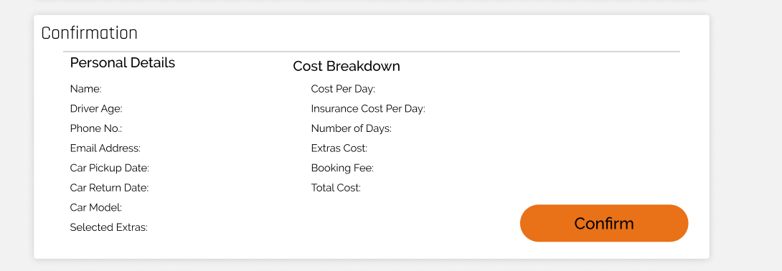
high fidelity wireframe – feedback - confirmation
https://trello.com/c/I7OYechR
I received feedback about how cost break down had a header while personal Details did not. As this looks inconsistent, I added a header to the personal Details column
final high-fidelity

Slide 21
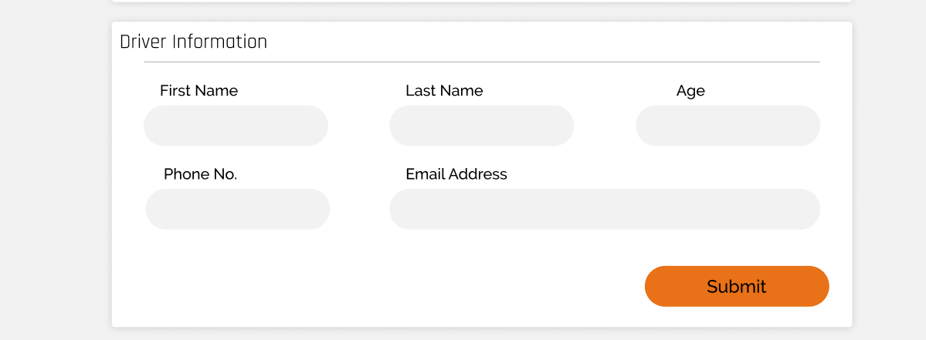
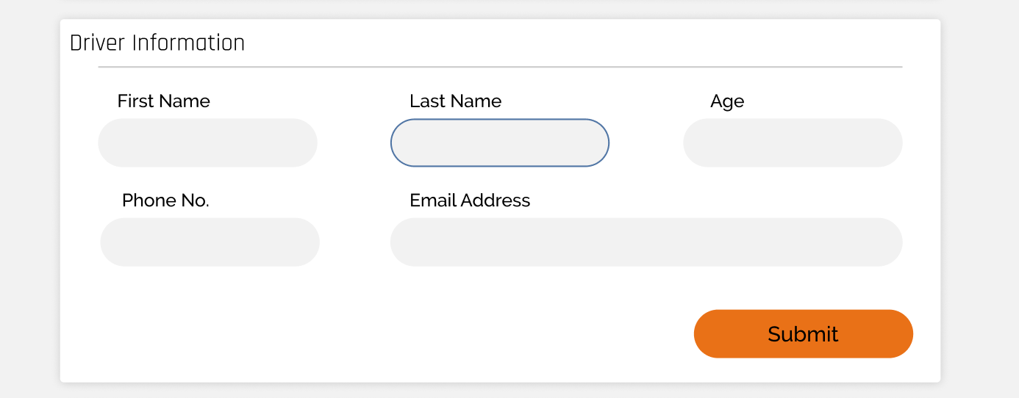
high fidelity wireframe – feedback- blue border around current input
https://trello.com/c/I7OYechR
I received feedback saying that my color palette did not suit because there was only one location where blue was used. For this reason and to make it easier for the user to identify which box they are currently inputting to I added a blue border around the input field that is currently being inputed
final high-fidelity

Slide 22
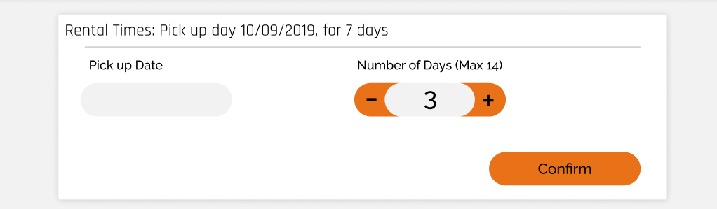
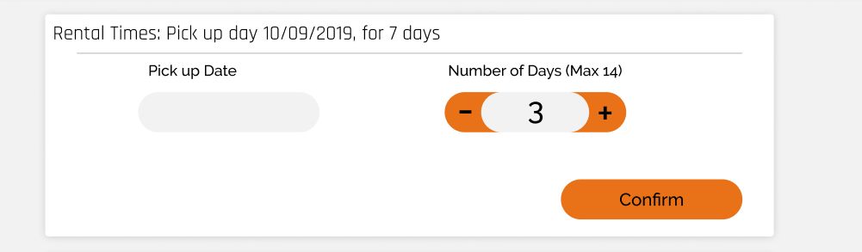
high fidelity wireframe – feedback – rental times columns
https://trello.com/c/I7OYechR
I received feedback saying the rental times cards columns looked odd. I therefore did as the feedbacker recommend and centered the input in each of its own columns.
final high-fidelity

Slide 23
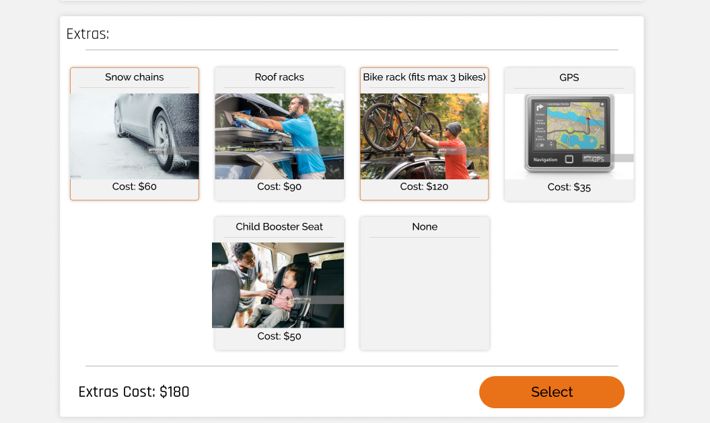
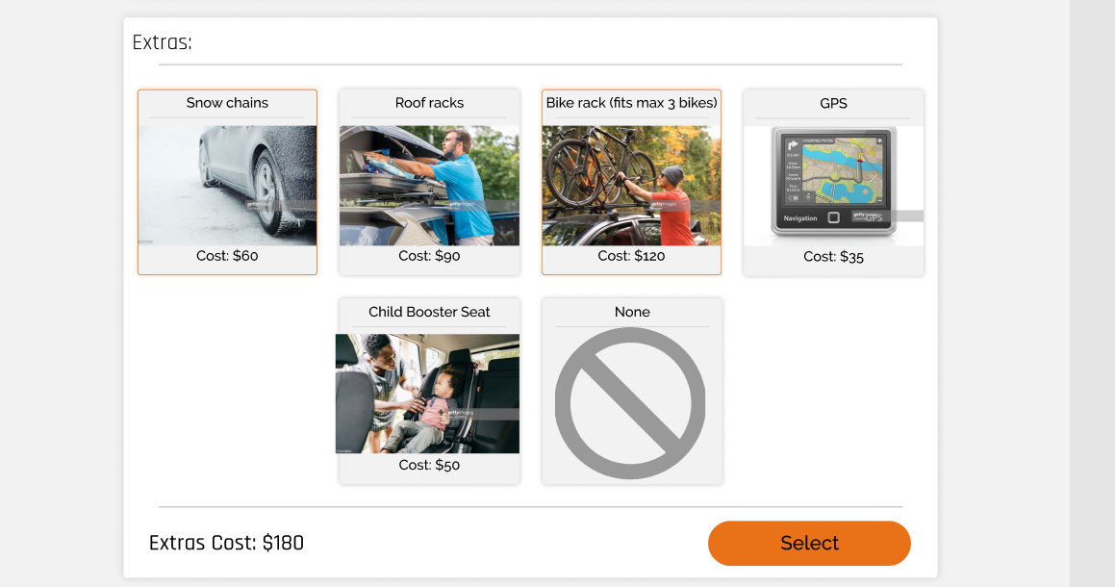
high fidelity wireframe – feedback – cross image
https://trello.com/c/I7OYechR
I received feedback about the none option in the extras card. I added the cross image to make it clearer what it does and to suit the design of the page better.
final high-fidelity

Slide 24
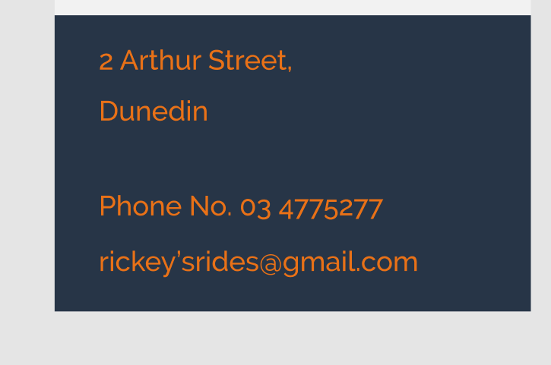
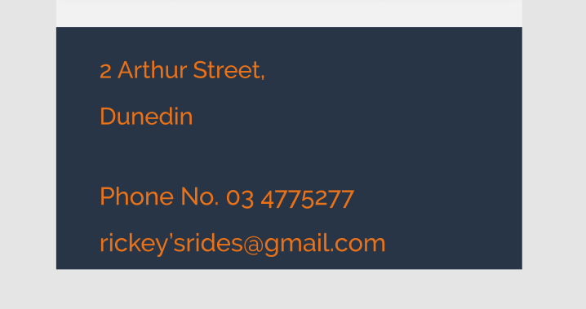
high fidelity wireframe – feedback – footer font
https://trello.com/c/I7OYechR
I received negative feedback on the footer design on mobile. I decreased the font size of text in the footer as it was previously very large
final high-fidelity

Slide 25
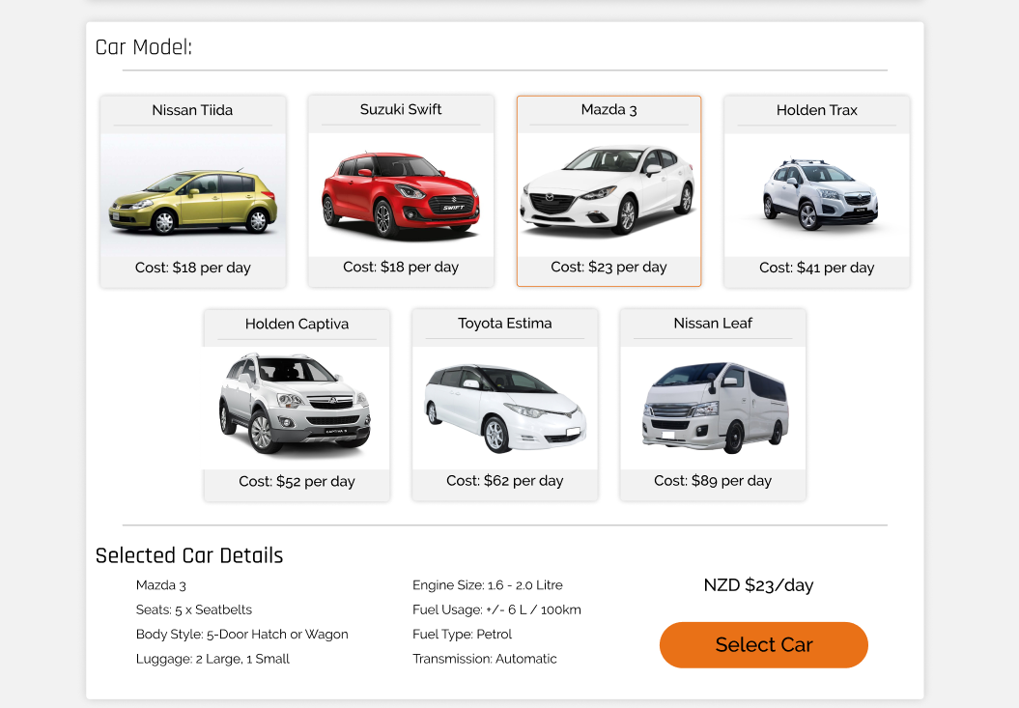
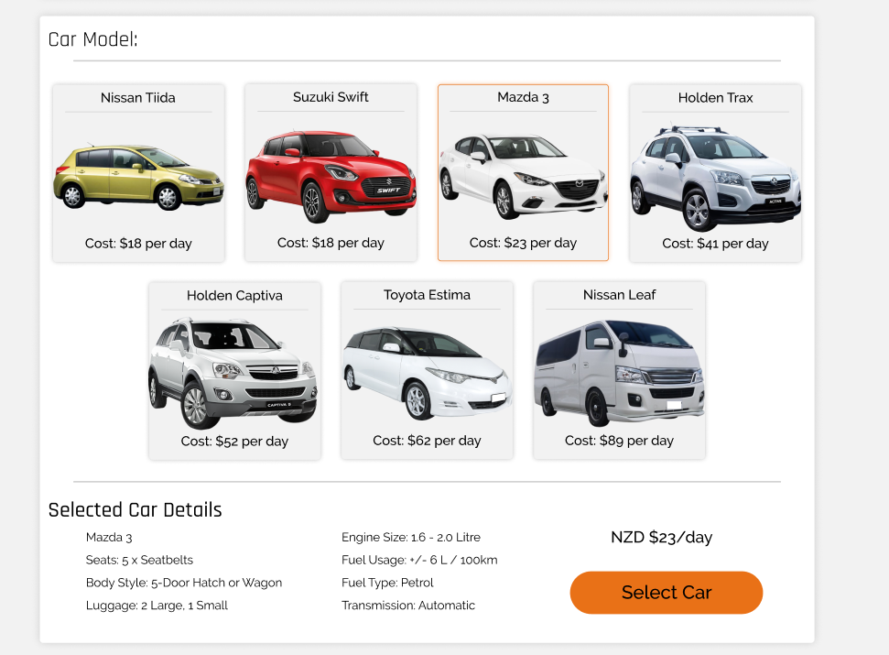
high fidelity wireframe – feedback – images
https://trello.com/c/I7OYechR
I received feedback stating that the car images did not look good with the background that adds another border within the card and that some of the cars were pointing one direction while other were pointing the other direction. Therefore I edited the pictures so that the background was transparent which required me to convert the images to PNG and flipped some of the images so that all the cars were facing one direction
final high-fidelity

Slide 26
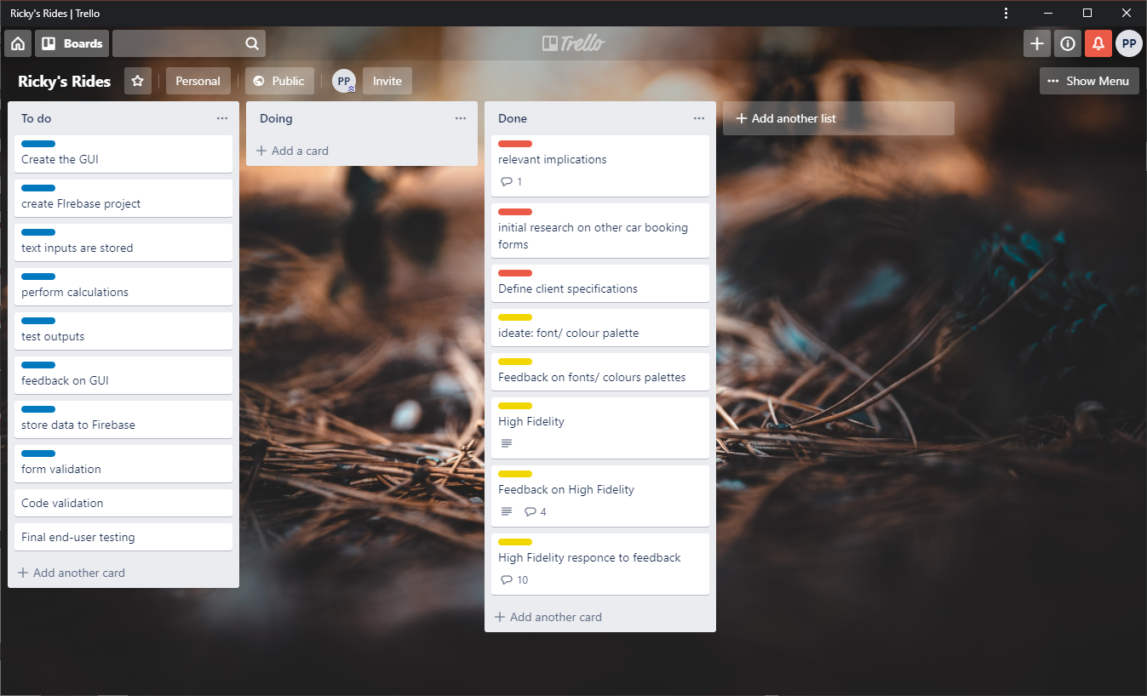
PROJECT MANAGEMENT TOOL: TRELLO
Current Trello board

Slide 27
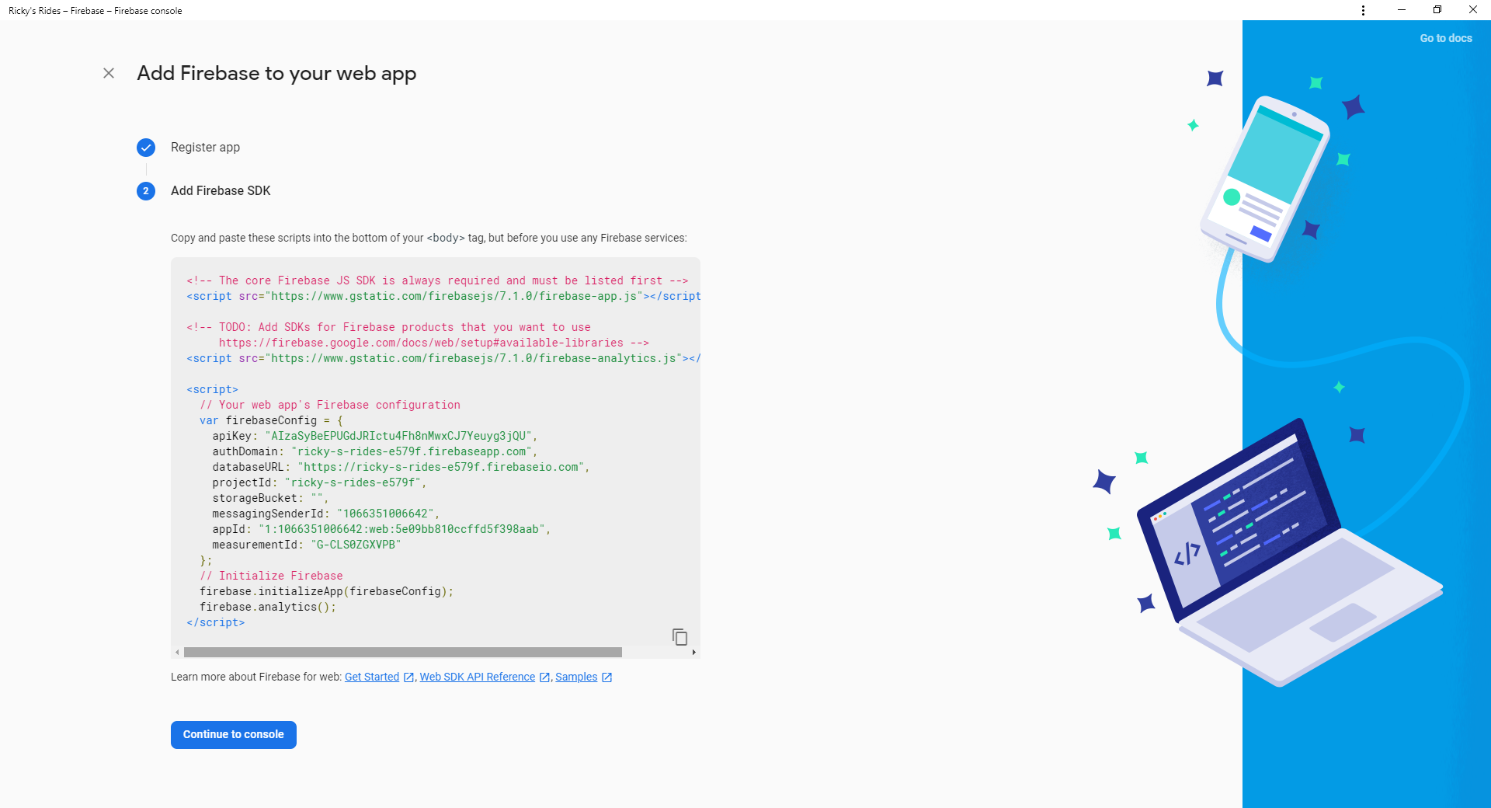
Firebase set up
Before building my site I set up my firebase and created a real time database that I will use later

Slide 28
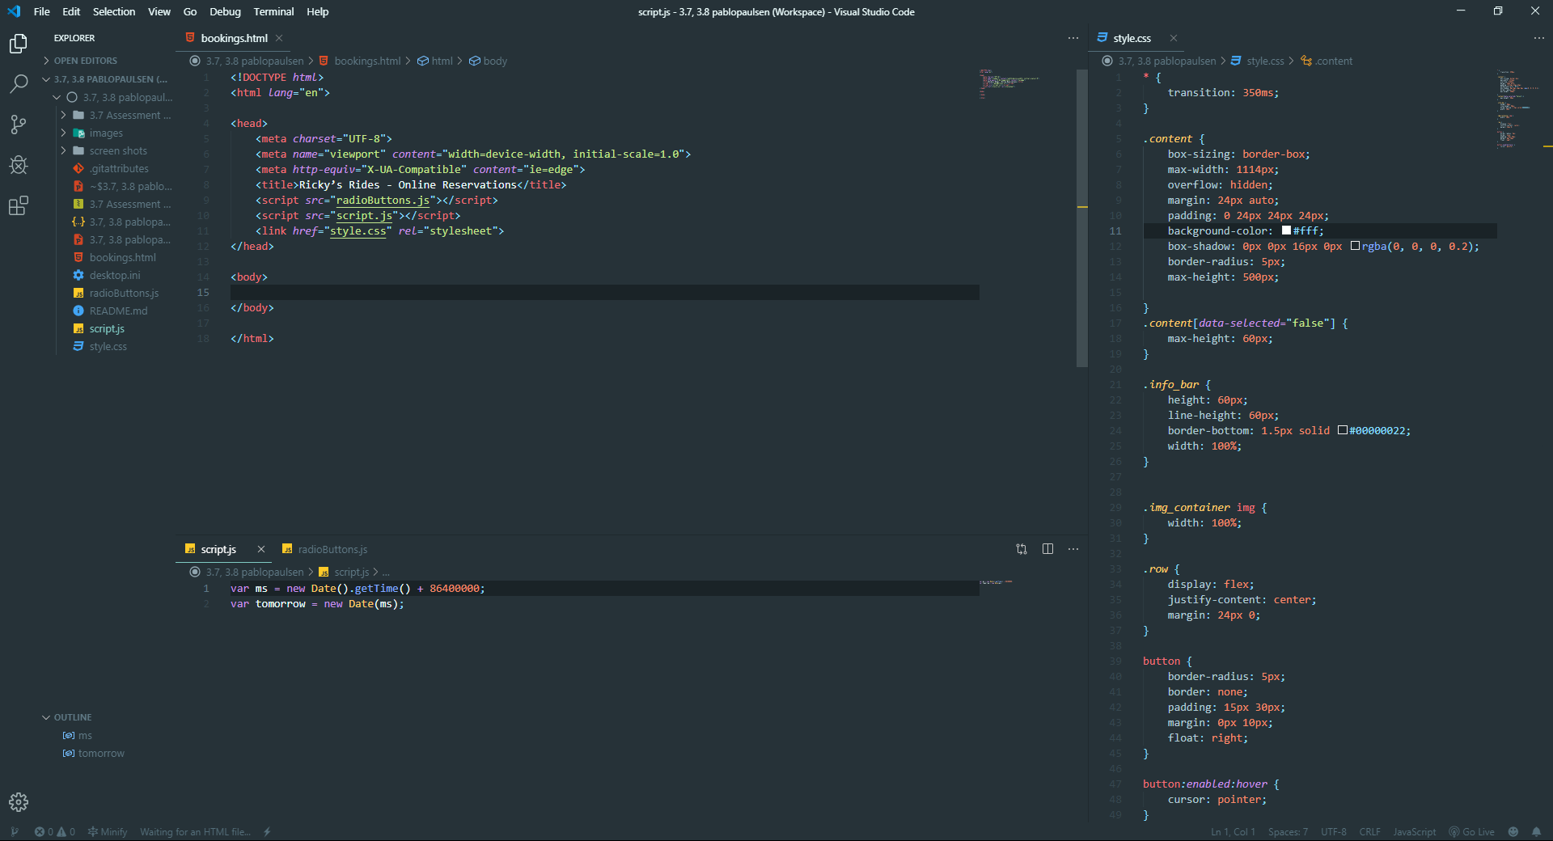
Coding setup
I set up my code workspace file so that on opening visual studio is opened as in the image and have access to GitHub for version control and backup.

Slide 29
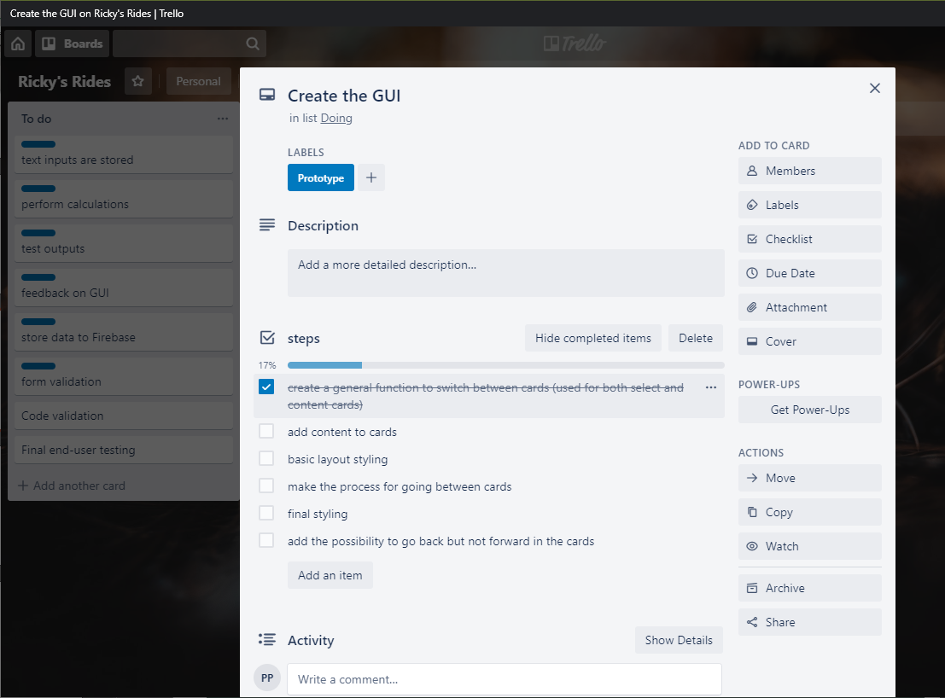
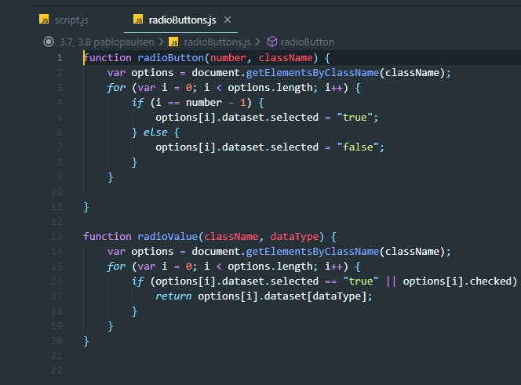
Set up the GUI
As creating the GUI is a long process I set up a checklist on my trello board of steps to do.
First I set up a JavaScript function that adds a dataset selected to the selected card. I did this first as it will be used many times for the content cards and also the car/extras selection cards. I also make a function will return the value of the currently selected card. This will be used later when storing the inputted data

Slide 30
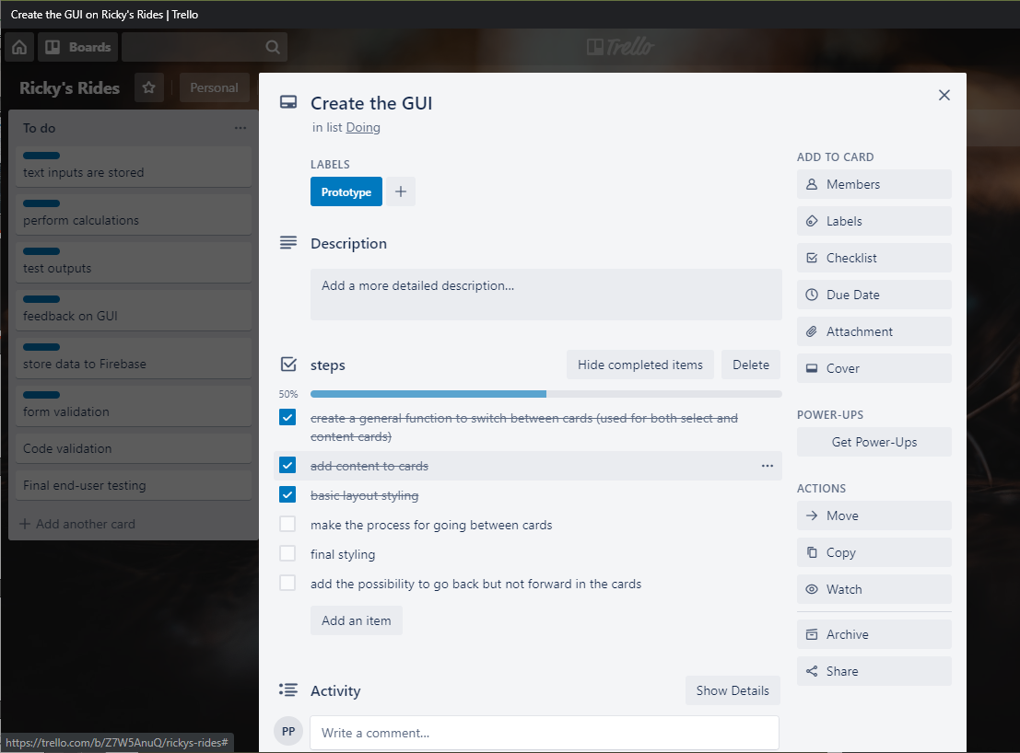
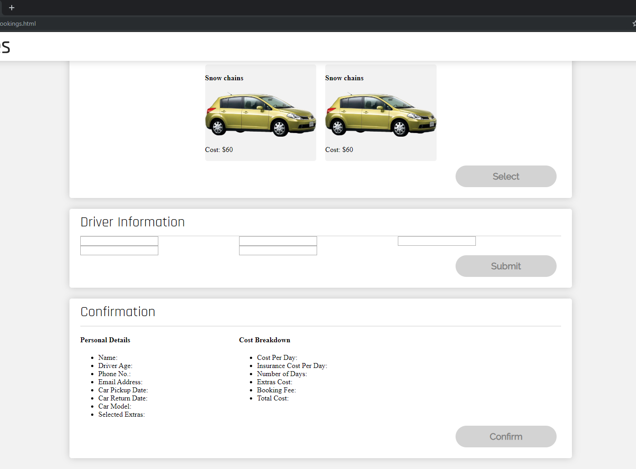
Set up the GUI
I started setting up my GUI by adding all the content while still using placeholder images and did some basic styling to make sure that everything is in the approximate location it need to be in. to improve efficiency and flexibility of my code when making the input boxes and output summary I used display flex as it allows for better arrangement of content into columns

Slide 31
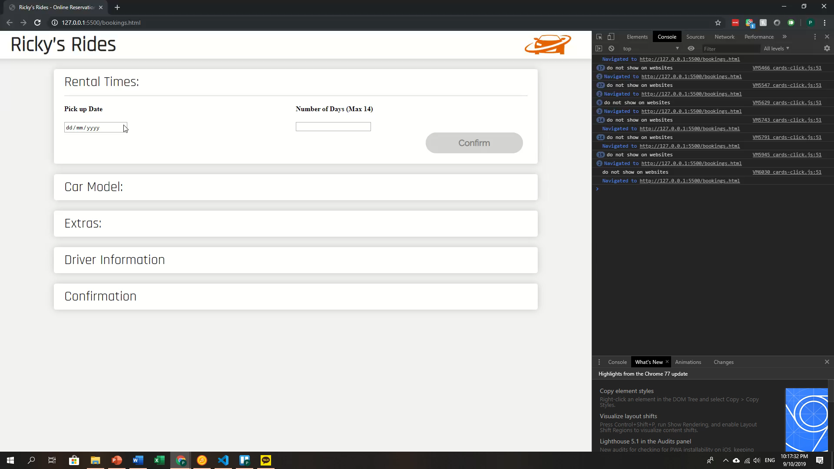
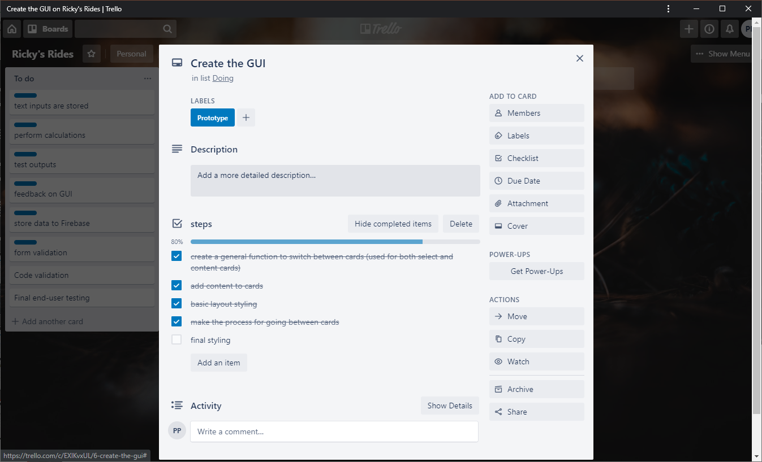
Set up the GUI
I made the JavaScript so that when the user is able to click the confirm button once all of the inputs are entered.

Slide 32
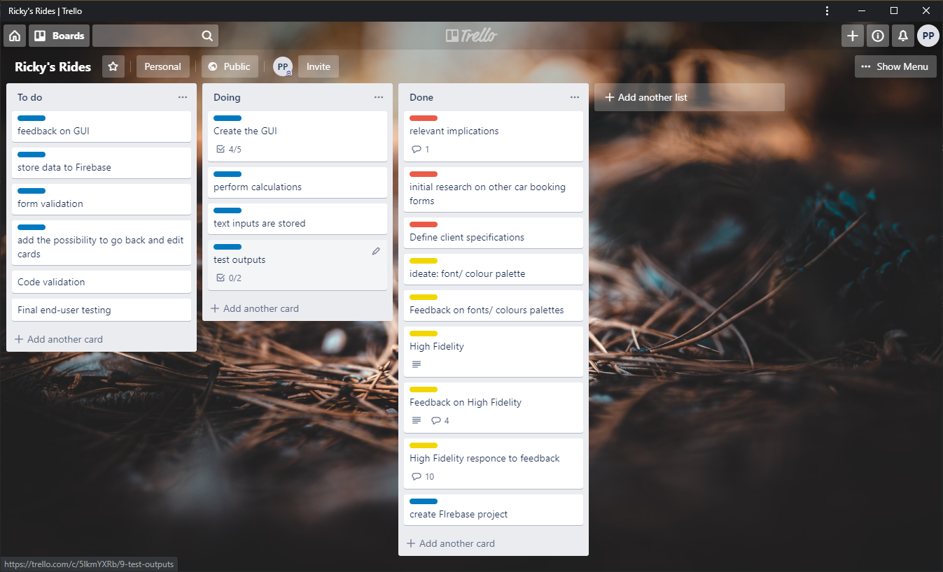
PROJECT MANAGEMENT TOOL: TRELLO
Current Trello board
I added the card ‘add possibility to go back and edit cards’ as this is a feature, I would like to add later.
Added the cards related to output to doing as with my current design this is done at onces

Slide 33
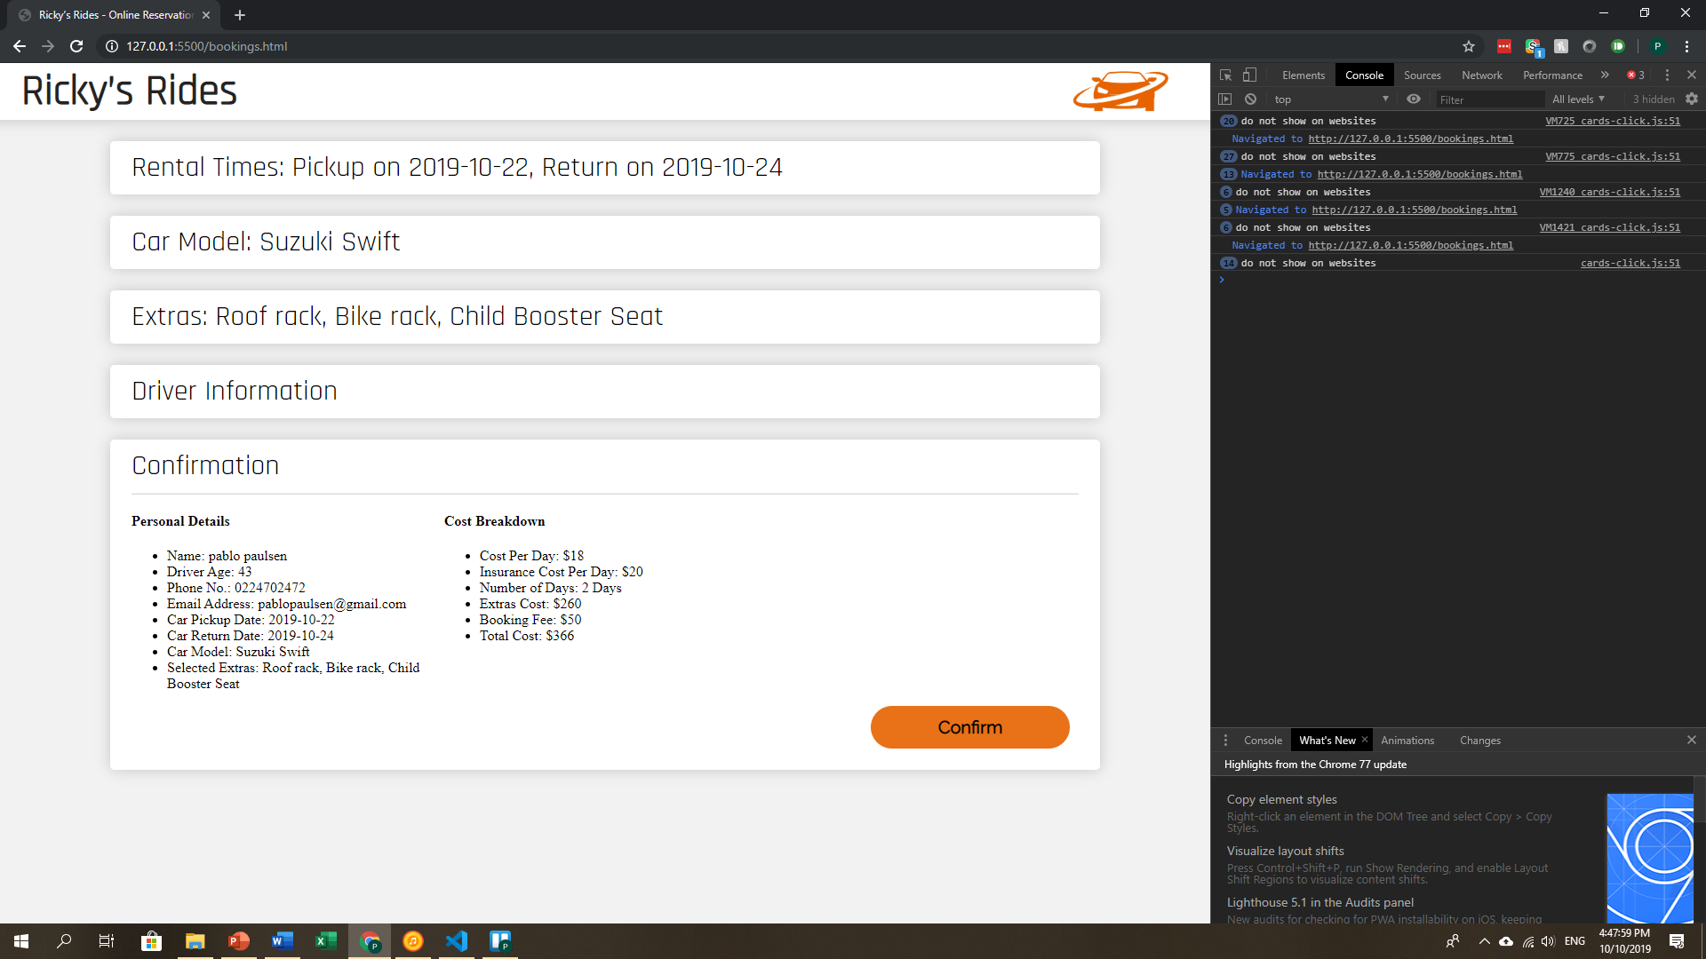
Outputs summary
I made all my outputs In the confirm card display and also a short summary on each card

Slide 34
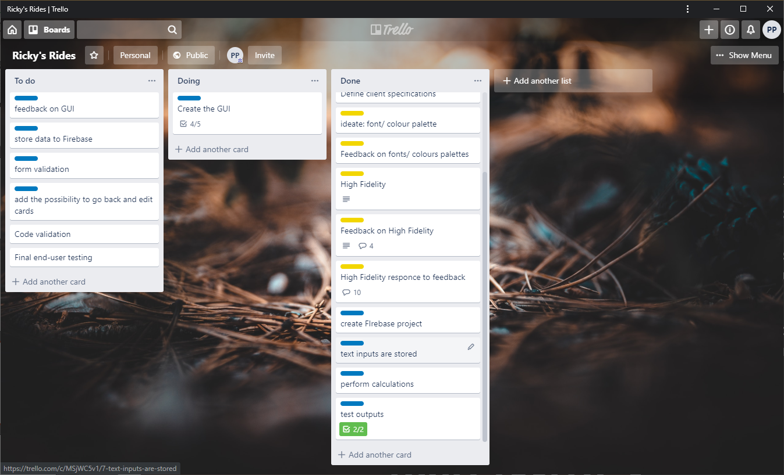
PROJECT MANAGEMENT TOOL: TRELLO
Current Trello board

Slide 35
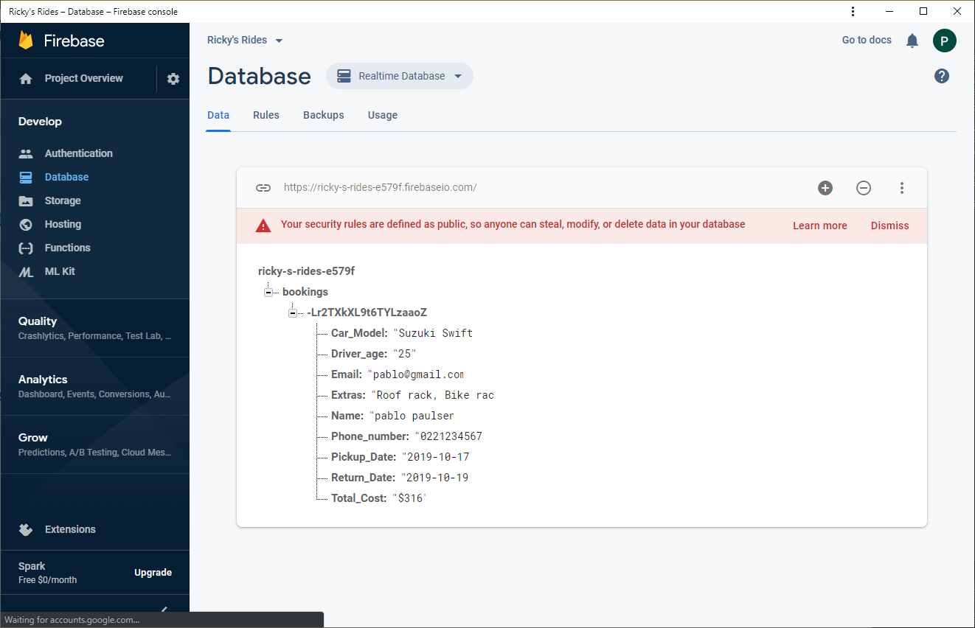
Data pushed to firebase
I linked my firebase so that on the click of the confirm button the data in the output summary is sent to firebase

Slide 36
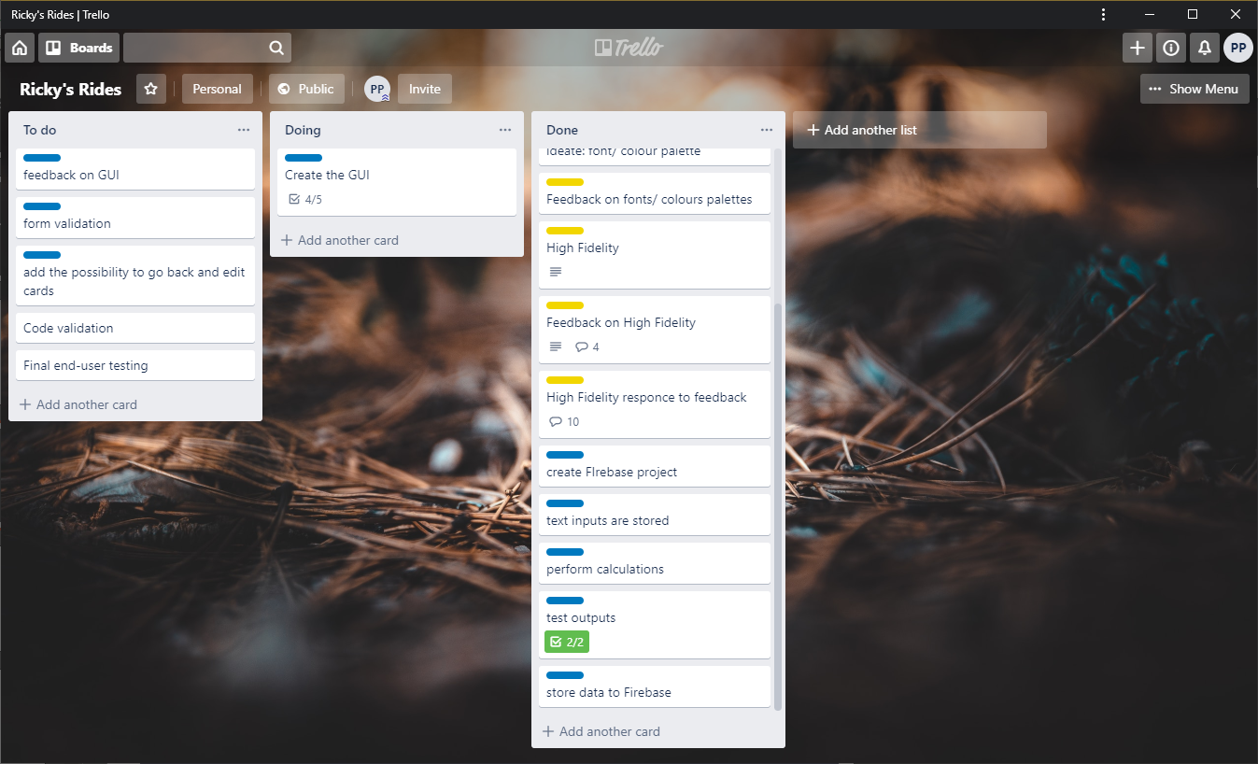
PROJECT MANAGEMENT TOOL: TRELLO
Current Trello board

Slide 37
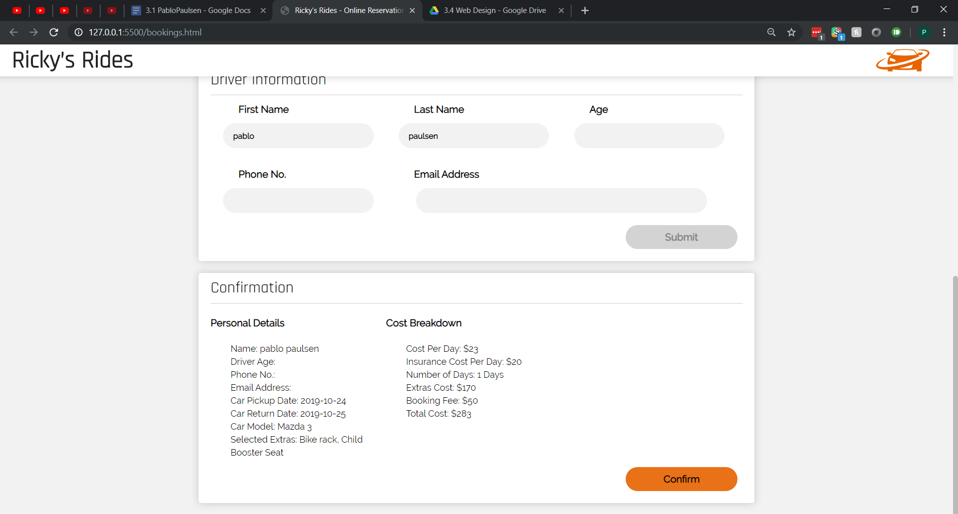
Set up the GUI
I did the final touch ups of the styling of the pages so that the inputs and output field display the font matching the design

Slide 38
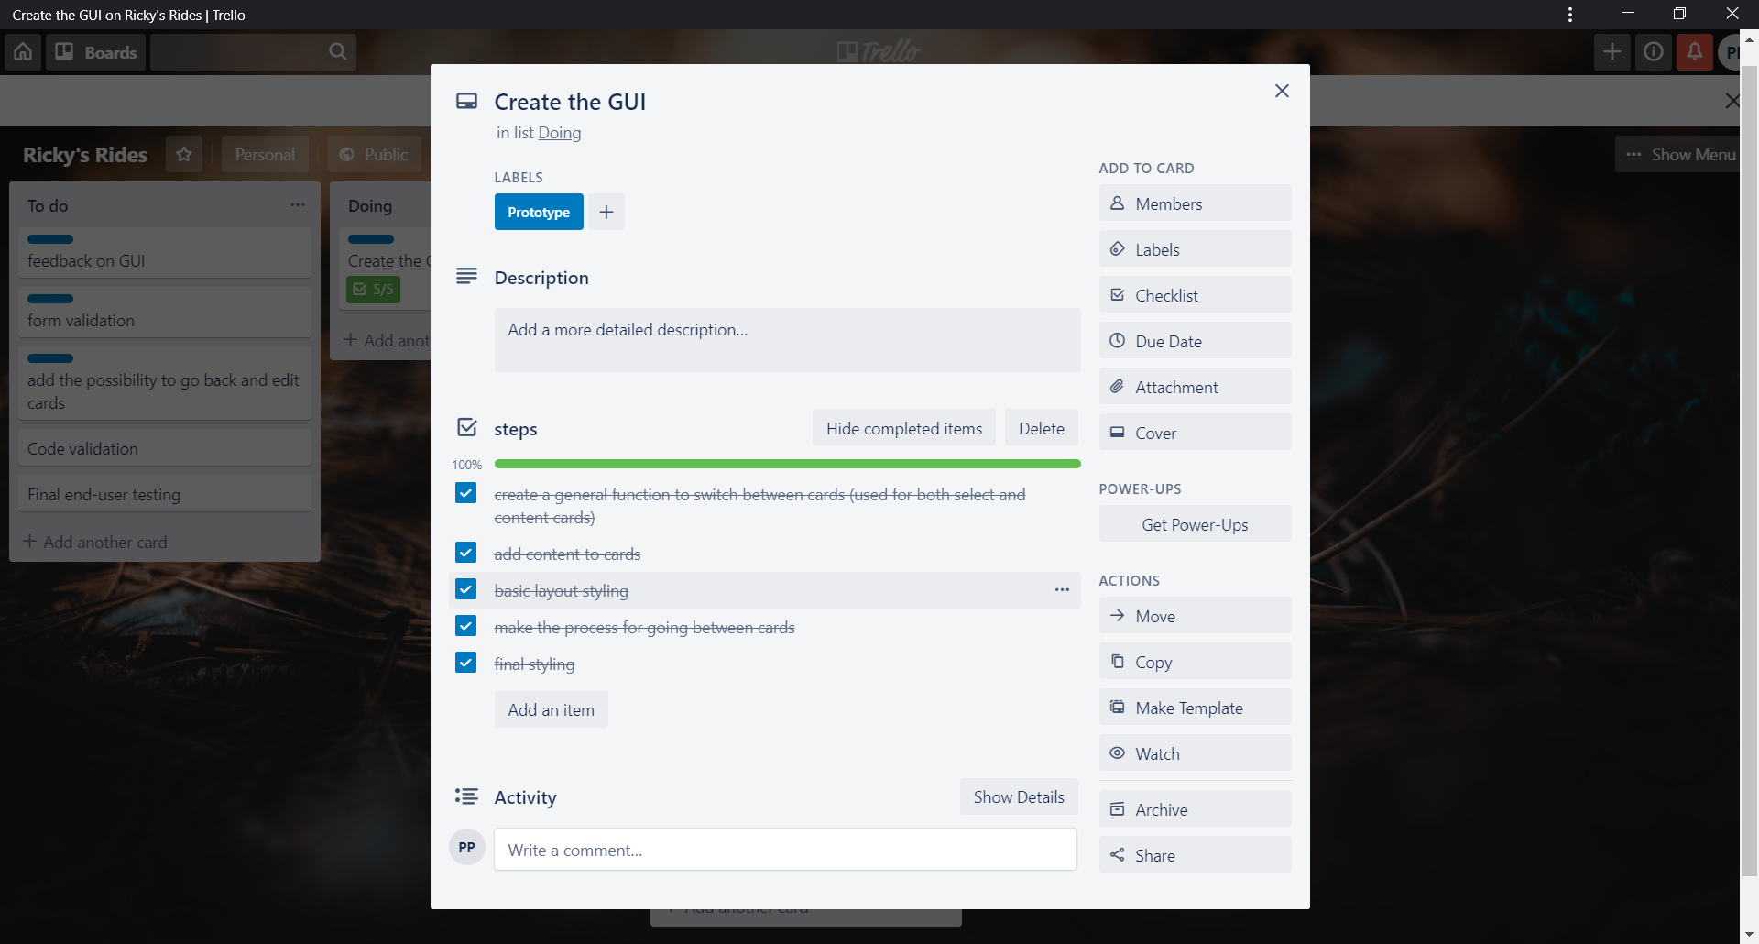
PROJECT MANAGEMENT TOOL: TRELLO
Current Trello board

Slide 39
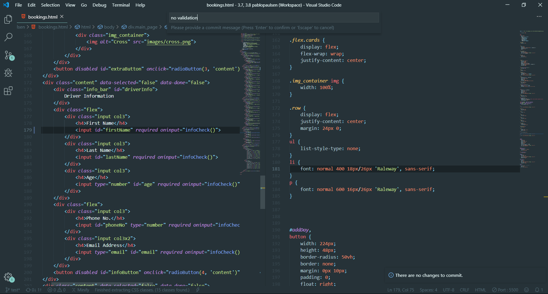
Version control
Every time I added new functionality I committed my files to git so that if something goes wrong with the code I am able to revert back to a previous version

Slide 40
Trialing inputs

Slide 41

FEEBACK ON THE USABILILTY
I shared my trello card to receive feedback on my current site. I explained that I did not yet have validation but I want feedback on the functionality of the interface.

Slide 42
FEEBACK ON THE FUNCTIONALITY

Slide 43
FEEBACK ON THE ASETHETHICS

Slide 44
FEEBACK ON THE USABILILTY

Slide 45
Trialing layouts

Slide 46
Trialing outputs / error messages

Slide 47
Trialing outputs / error messages

Slide 48
Improving the functionality

Slide 49
Trialing outputs / error messages

Slide 50
Debugging : works on expected data

Slide 51
Debugging : works on expected data

Slide 52
Debugging : works on expected data

Slide 53
Debugging : works on expected data

Slide 54
Debugging : works on expected data

Slide 55
Debugging : works on boundary data

Slide 56
Debugging : works on boundary data

Slide 57
Debugging : works on invalid data

Slide 58
FEEDBACK ON GUI

Slide 59
REFINEMENTS

Slide 60
REFINEMENTS

Slide 61
REFINEMENTS

Slide 62
Evidence of Code Validation (html)

Slide 63
Evidence of Code Validation (css)

Slide 64
Evidence of Code Validation (JS)

Slide 65
Evidence of code comments (HTML/CSS/JS)

Slide 66
Persistent Storage (Firebase database) SETUP

Slide 67
Persistent Storage (Firebase database)
Firebase database

Slide 68
Persistent Storage (Firebase database)
Final video of testing evidence / split screened GUI with Firebase

